Slide 1
CHAPTER 3 Well posed predictive control 8 Summary of horizon choice for given weights
Anthony Rossiter

Slide 2
Observations
The optimisation of J is only meaningful if the optimised trajectories are close to the closed-loop responses that result.
If the optimised predictions differ significantly from the closed-loop behaviour, then the predictions are meaningless and thus the optimisation is meaningless as they do not represent what is actually going to happen.
There must also be a close match between predictions and the behaviour we actually want, otherwise our optimisation cannot lead us to the behaviour we want!
Examples have shown that there is a close match between predictions and closed-loop behaviour, if and only if some conditions are met.

Slide 3
Observations
The numerous examples tended to indicate that:
The output horizon should be well beyond the system open-loop settling time so that ignored tracking errors are zero.
The input horizon must be long enough to capture the entire desired closed-loop input trajectory – otherwise there is a mismatch between what the optimisation can offer and what you want.
The required horizons may change with the control weighting, as the weighting has an impact on the desired speed of response.

Slide 4
Choice of parameters
In many cases one could estimate the required input and output horizons fairly easily.
Typically the output horizon should be a little over the open-loop settling time, but could be more if the target closed-loop dynamic is slower.
The required input horizon depends upon the open-loop behaviour:
If the open-loop behaviour is good, nu=1 may be sufficient as a simple change in the input could be enough.
If the open-loop behaviour is bad, one needs to know how many control moves are required, while not over-actuating, in order to force desirable behaviour.
It may require some trial/error simulation to establish this.
What constitutes a long enough prediction horizon and large enough control horizon is not fixed!

Slide 5
Simple proposal
Note this is for open-loop stable systems only and assumes a computer accuracy not subject to numerical ill-conditioning.
Use ny and nu which are obviously larger than required.
Find the closed-loop responses.
Identify the length of the key input and output dynamics and select these as the appropriate minimum choices for ny and nu.

Slide 6
gpc3_8_example1
For λ=1, a choice of ny=10 and nu=5 should be enough!
ny=10, nu=5 give near identical control to ny=40 and nu=20.

Slide 7
gpc3_8_example1
For λ=100, a choice of ny=15 and nu=7 should be enough!
ny=15, nu=7 give near identical control to ny=40 and nu=20.
In fact smaller also does the job quite well

Slide 8
gpc3_8_example2
For λ=1, a choice of ny=10 and nu=5 should be enough!
ny=10, nu=5 give near identical control to ny=40 and nu=20.

Slide 9
gpc3_8_example3
For λ=1, a choice of ny=8 and nu=6 should be enough!
ny=8, nu=6 give near identical control to ny=40 and nu=20.

Slide 10
gpc3_8_example4
For λ=0.1, a choice of ny=6 and nu=4 should be enough!
ny=6 nu=4 give near identical control to ny=40 and nu=20.
Try smaller nu and you will see this is no longer true.

Slide 11
Reflections on horizons
Long enough cannot easily be defined in advance.
The output horizon must be some samples longer than it takes the predictions to get to steady-state.
This tends to mean well over the open-loop settling time, especially if the control action is smooth (not aggressive).
The input horizon should be long enough to capture the ‘ideal’ closed-loop input trajectory.
This could be close to the open-loop settling time but is dependent upon the target tuning (FAST or SLOW).

Slide 12
CAVIATS
So far we have considered the unconstrained case.
The best horizons may well change in the presence of constraints such as rate limits on the inputs. However, the same philosophical thinking will apply.
So far we have also ignored the availability, or not, of advance information on the target.
It is noted that for open-loop unstable systems, that while GPC seems to work OK, it is not really a well defined algorithm for this case and should be used with extreme caution.

Slide 13
CONCLUSIONS
The horizons ny and nu are not tuning parameters or indeed ‘options’.
If not chosen correctly and systematically, then the optimisation will be ill-posed in that optimising J need not imply sensible or good overall trajectories.
Optimising J, tells you the best with restricted d.o.f. over a restricted horizon and this could be seriously flawed.
You can have confidence with GPC/DMC if and only if the horizons are long enough – it may take some offline testing to be sure of this.
I would recommend beginning from values that are close to the ideal closed-loop dynamics.

Slide 14
Remark
If you are happy with the open-loop dynamics and thus an input which essentially moves directly to the expected steady-state then a simpler alternative exists.
You could use nu=1 and ny very very large and lambda small.
A simpler option would be simply to use the observation:
This uses an estimate for ‘d’ which incorporates the feedback. Either way, prediction and optimisation not needed!

Slide 15



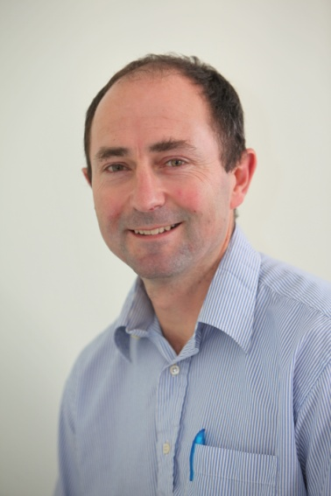
Anthony Rossiter
Department of Automatic Control and Systems Engineering
University of Sheffield
www.shef.ac.uk/acse
© 2014 University of Sheffield
This work is licensed under the Creative Commons Attribution 2.0 UK: England & Wales Licence. To view a copy of this licence, visit http://creativecommons.org/licenses/by/2.0/uk/ or send a letter to: Creative Commons, 171 Second Street, Suite 300, San Francisco, California 94105, USA.
It should be noted that some of the materials contained within this resource are subject to third party rights and any copyright notices must remain with these materials in the event of reuse or repurposing.
If there are third party images within the resource please do not remove or alter any of the copyright notices or website details shown below the image.
(Please list details of the third party rights contained within this work.
If you include your institutions logo on the cover please include reference to the fact that it is a trade mark and all copyright in that image is reserved.)

